Slide 1

Statistical Model Selection & Hypothesis Development
W4 Deliverables
DATA 200
APPLIED STATISTICAL ANALYSIS
Team Members: Kriti Nepal, Aditi Dahal, Samriddhi Sai Khadka
Notes:
1

Slide 2
Understanding the Problem
The Problem: Schools lack clear, data-driven insights into how study habits, attendance, and background factors influence academic outcomes.
Our Objectives:
01
02
03
Identify Key Factors
Build Predictive Models
Enable Data-Driven Decisions
Determine which variables most strongly influence student grades
Create statistical models to forecast performance outcomes
Provide actionable insights for academic intervention strategies
Notes:
2

Slide 3






Why Statistical Modelling?
Measure Relationships
Quantify connections between variables with precision
Quantify Impact
Determine exactly how much each factor affects academic scores
Test Hypotheses
Apply scientific rigour to validate assumptions
Predict Outcomes
Forecast future student performance with confidence
Notes:
3

Slide 4

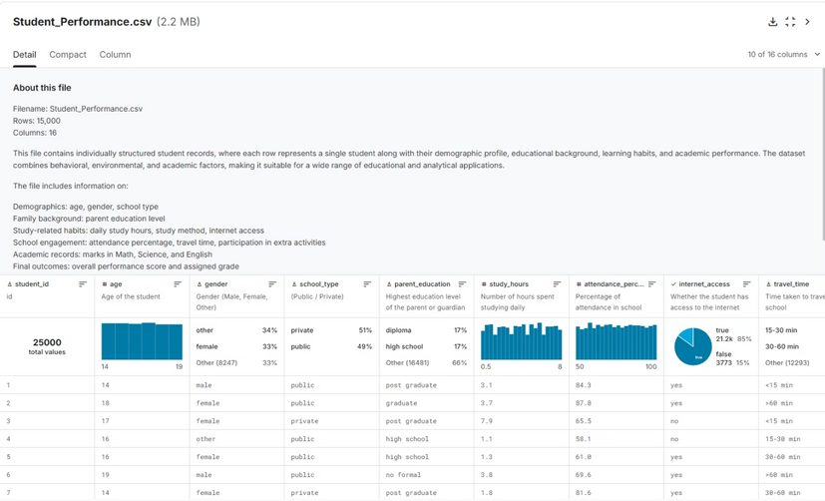
DATA
Dataset Overview
Demographics
Family Context
Study Patterns
Age, gender, school type
Parental education levels
Hours studied, methods, internet access
Engagement Metrics
Academic Results
Attendance, travel time, activities
Subject scores, overall grade
Notes:
4

Slide 5



Models Evaluated
Linear Regression
Logistic Regression
ANOVA
Purpose: Predict continuous score values
Purpose: Predict categorical outcomes
Purpose: Compare group performance
Quantifies how each factor increases or decreases marks
Estimates probability of Pass/Fail or grade groupings
Tests whether means differ across demographic segments
Notes:
5

Slide 6




SELECTION
Final Model Selection Rationale
Linear Regression
Logistic Regression
ANOVA
Target: Overall performance score
Target: Grade category (A/B/C/D/F)
Target: Group comparisons
Why: Numeric outcome reveals precise impact of each predictor
Why: Categorical outcome enables success/failure analysis
Why: Tests whether parental education or school type creates differences
Delivers: Coefficient values showing score changes per unit increase
Delivers: Probability estimates for each grade tier
Delivers: Statistical significance of group effects
These complementary models provide both prediction and explanation.
Notes:
6

Slide 7
Feature Selection Process
Selection Methodology
1
Correlation Analysis
2
Visual Pattern Recognition
Examined relationships identified during EDA phase
Reviewed scatterplots and distribution charts
3
Domain Knowledge
4
Relevance Filtering
Applied educational psychology principles
Prioritised variables with theoretical grounding
Notes:
7

Slide 8






Selected Key Predictors
These variables demonstrated strong empirical relationships with academic outcomes.
Study Hours
Attendance %
Parental Education
Subject Marks
Internet Access
Extracurriculars
Notes:
8

Slide 9
HYPOTHESES
Research Questions Framework
We developed testable hypotheses to systematically examine how different factors influence student performance.
H₁: Study Hours Effect
1
Students who dedicate more hours to study achieve significantly higher scores
2
H₂: Attendance Impact
Higher attendance rates correlate with improved academic outcomes
H₃: Parental Education
3
Family educational background positively influences student achievement
4
H₄: Subject Performance
Individual subject marks strongly predict overall academic results
H₅: Technology Access
5
Students with internet access demonstrate enhanced performance levels
These hypotheses guide our statistical testing framework and model interpretation.
Notes:
9

Slide 10
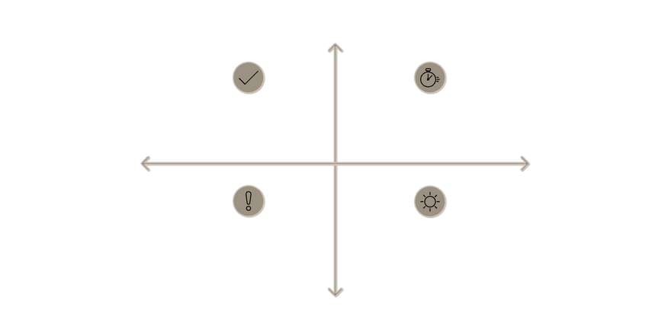







Formal Statistical Hypotheses
Study Hours
High Evidence for Effect
H₀: Study hours have no effect on scores
H₁: Study hours significantly improve performance
Reject H₀ — Strong evidence for H₁
Fail to reject H₀ — Evidence supports no effect
Attendance
Low Evidence for No Effect
High Evidence for No Effect
H₀: Attendance does not affect outcomes
H₁: Attendance positively impacts results
Type I Error — False positive (α)
Type II Error — False negative (β)
Parental Education (ANOVA)
Low Evidence for Effect
H₀: All groups have equal mean scores
Each research question translates into testable null and alternative hypotheses.
H₁: At least one group differs significantly
We'll test these using regression coefficients, p-values, and ANOVA F-statistics.
Notes:
10

Slide 11
Thank you
Notes:
11

